Slide 1
Language Detection
Hamza Ahmed 21L-6292
Zain Al Abidin 21L-6260

Slide 2
Source for scraping
Wikipedia

Slide 3
Preprocessing
Total Rows before pre processing : 500
Total Rows after pre processing : 500
Removed stop words i.e
“ . ”
“ , ”
“ ‘ ”
numbers

Slide 4
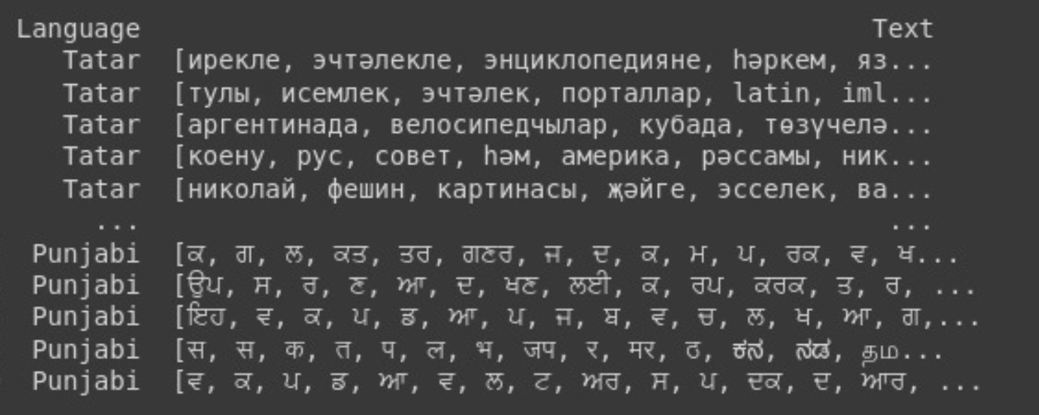

Slide 5
Approach 1 - Logistic Regression
Vectorization
Multi Class Logistic Regression
Accuracy : 6%

Slide 6
Approach 2 - RNN
Tokenization
4 Layers
Embedding Layer
LSTM
Global Max Pooling
Dense Layer
Accuracy : 77

